Slide 1
Relighting 3D Human Model

Slide 2
3Model with sunlighting with all possible angles with differ in 30 degrees

Slide 3
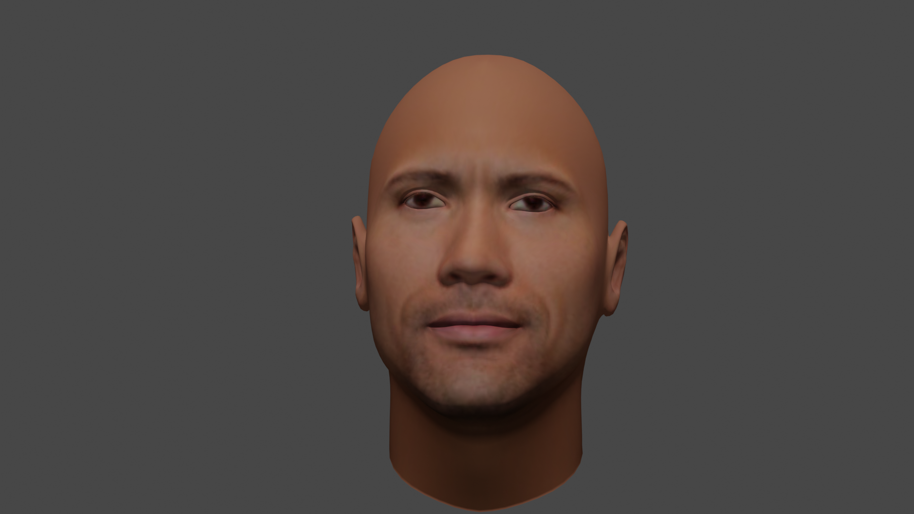
Image 1

Slide 4
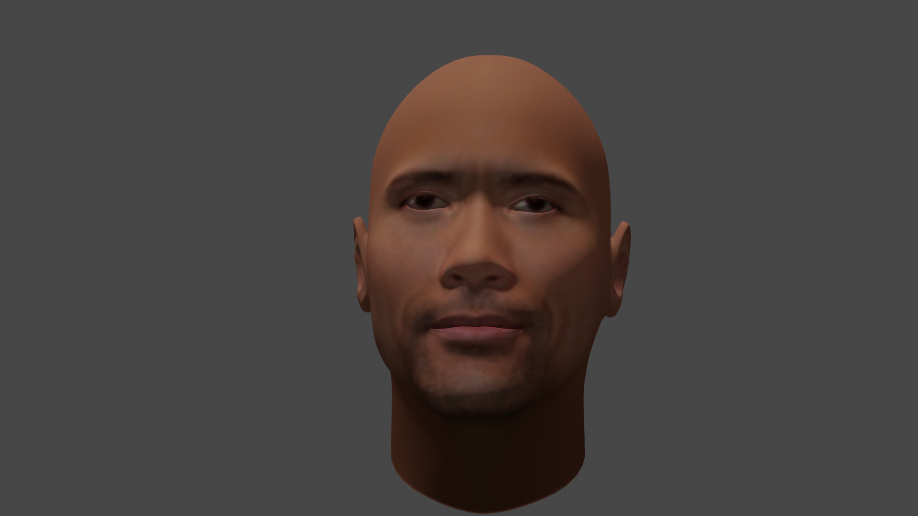
Image 2

Slide 5
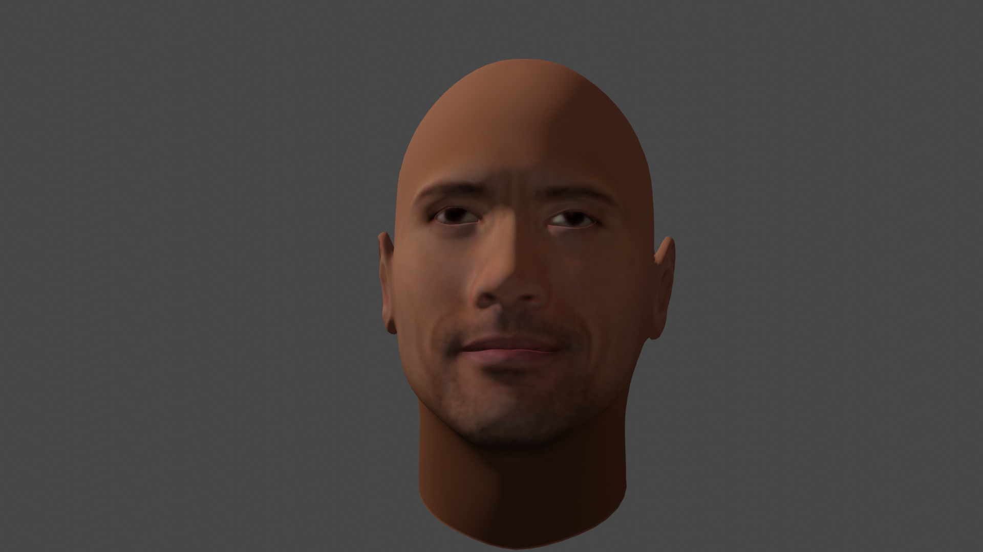
Image 3

Slide 6
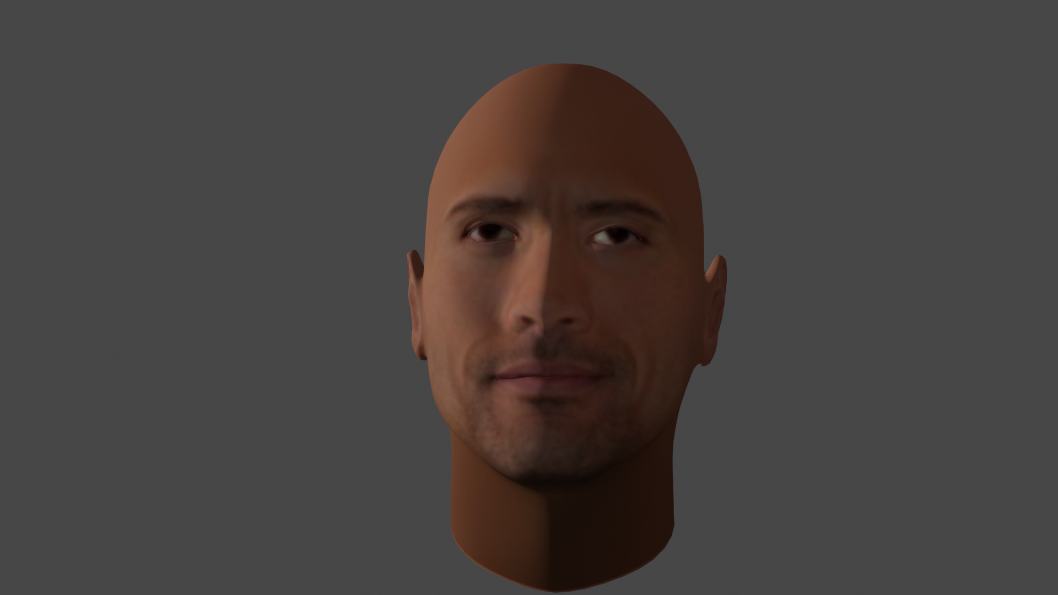
Image 4

Slide 7

Image 5

Slide 8
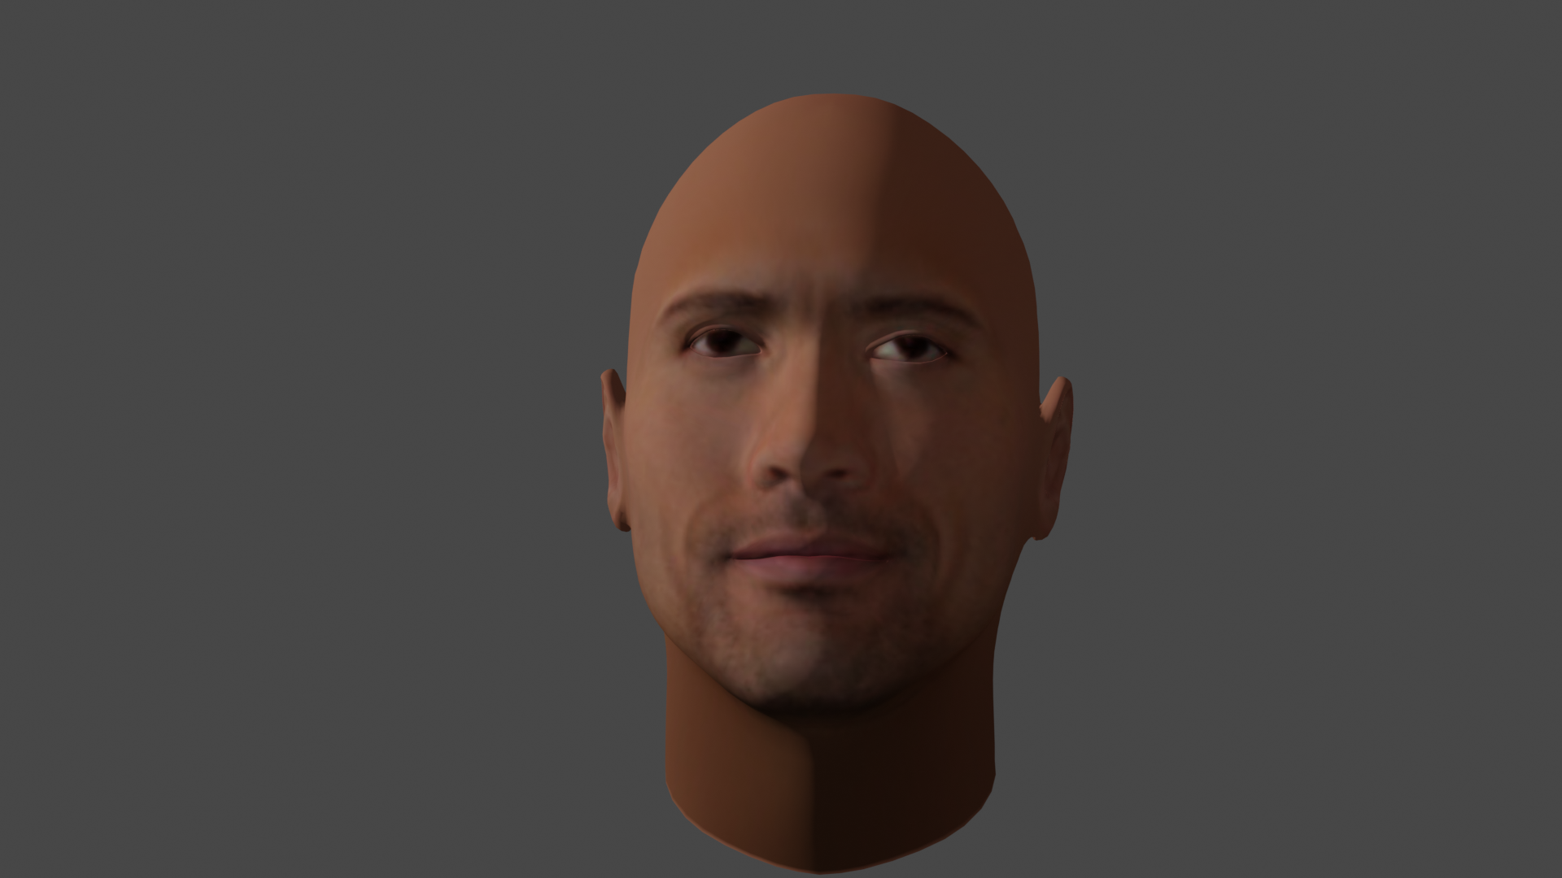
Image 6

Slide 9
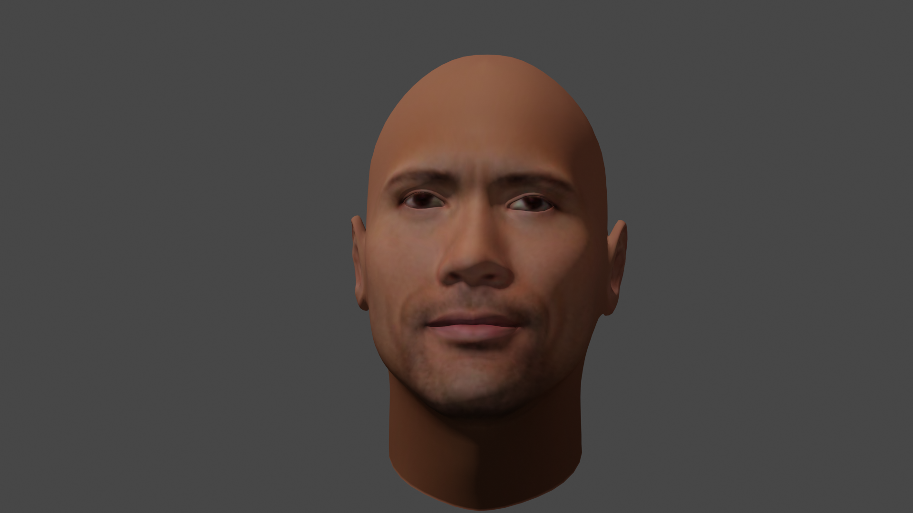
Image 7

Slide 10
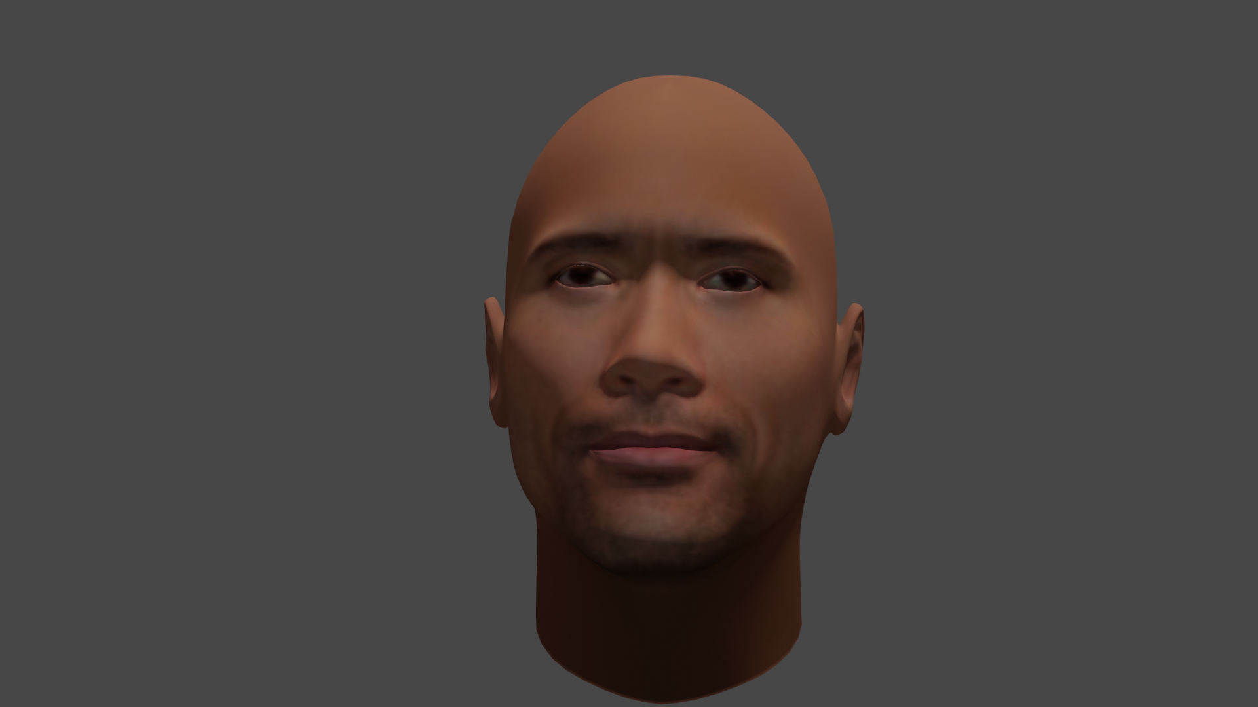
Image 8

Slide 11
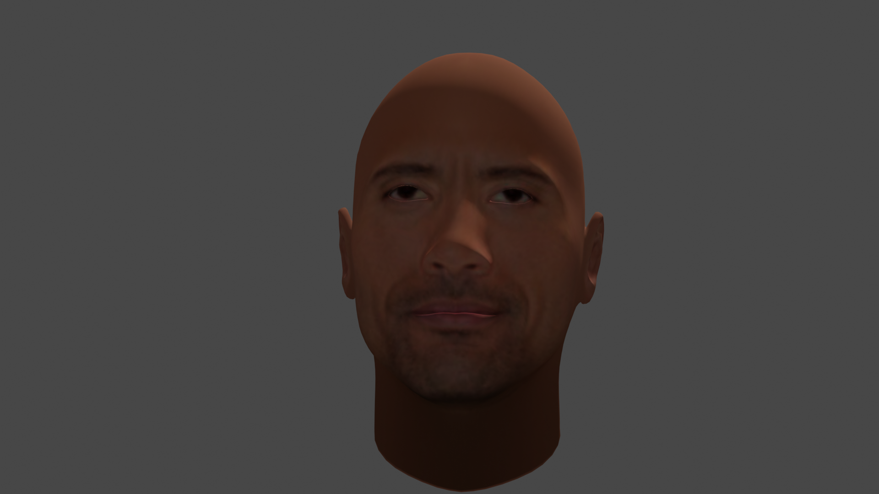
Image 9

Slide 12
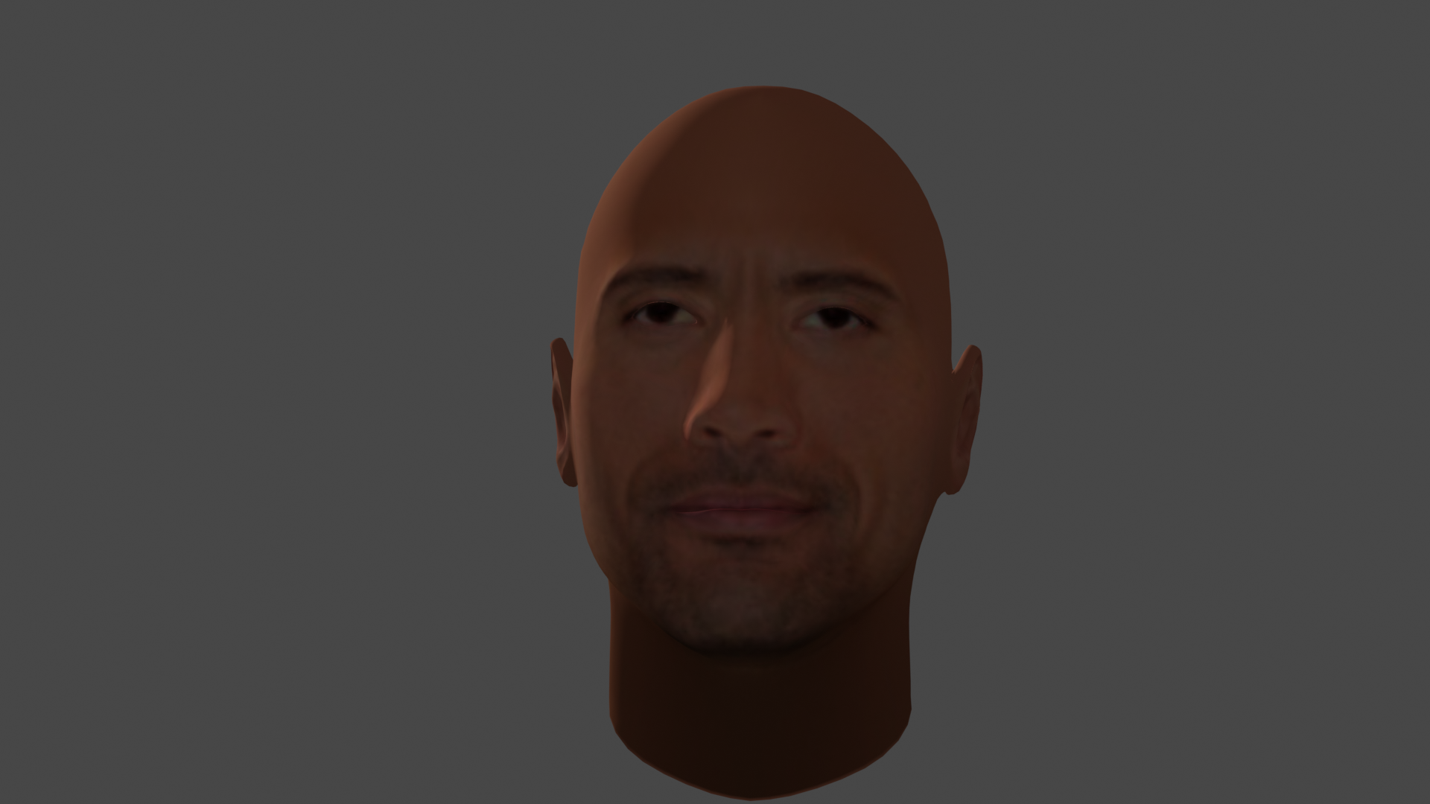
Image 10

Slide 13
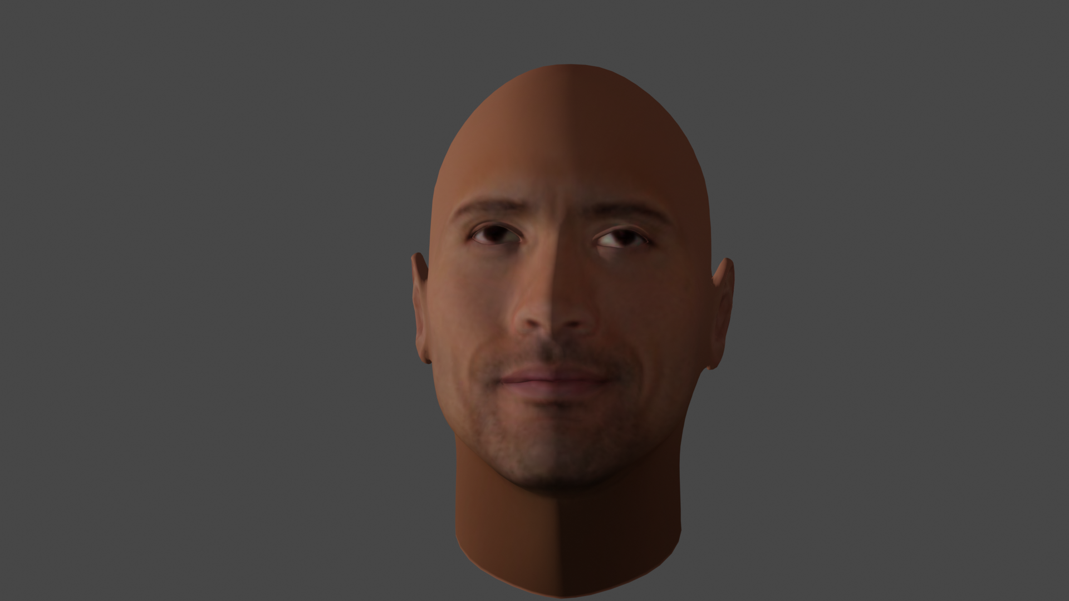
Image 11

Slide 14
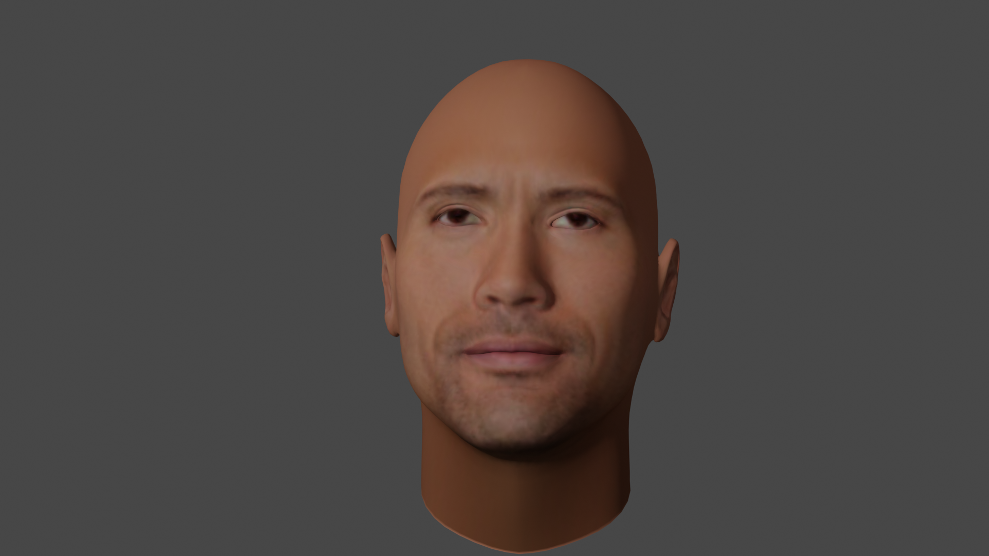
Image 12

Slide 15
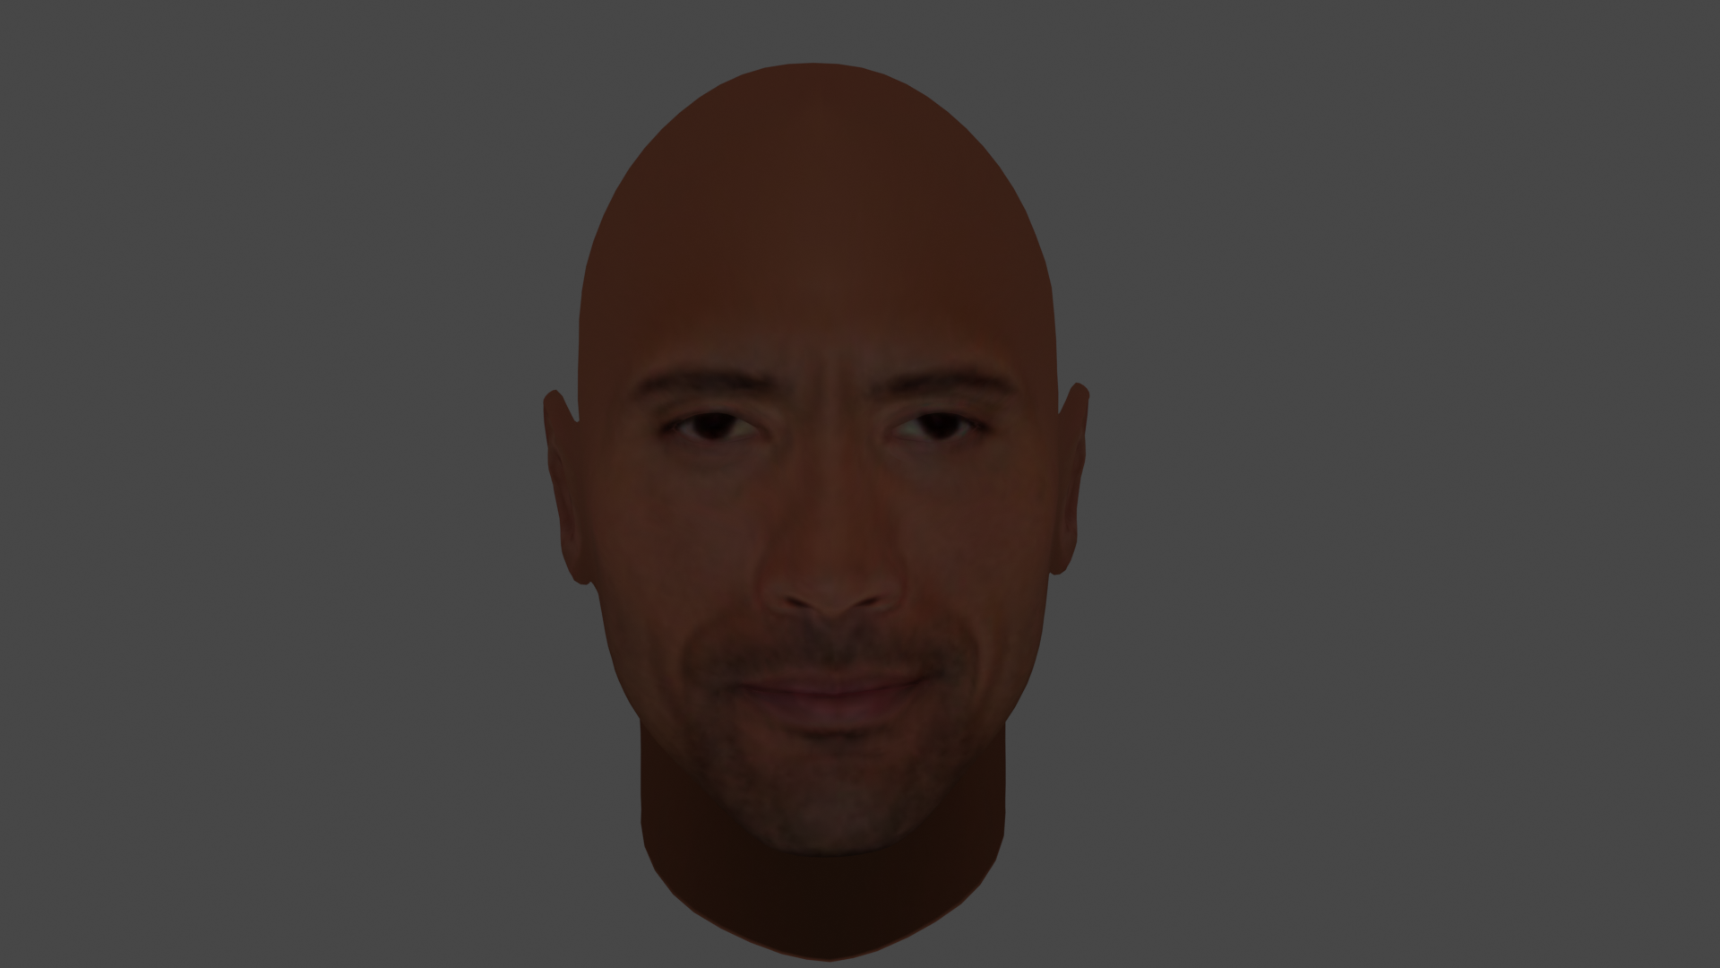
With point Lighting

Slide 16
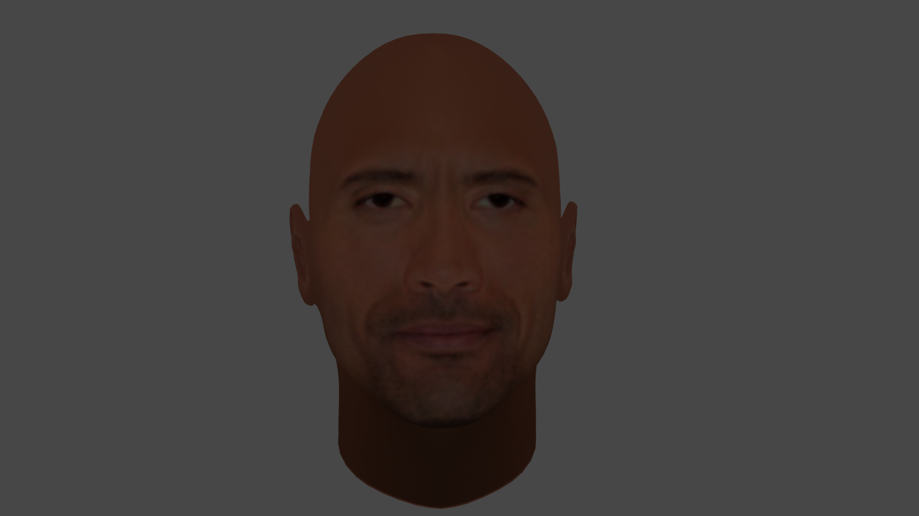
With Area
Lighting

Slide 17
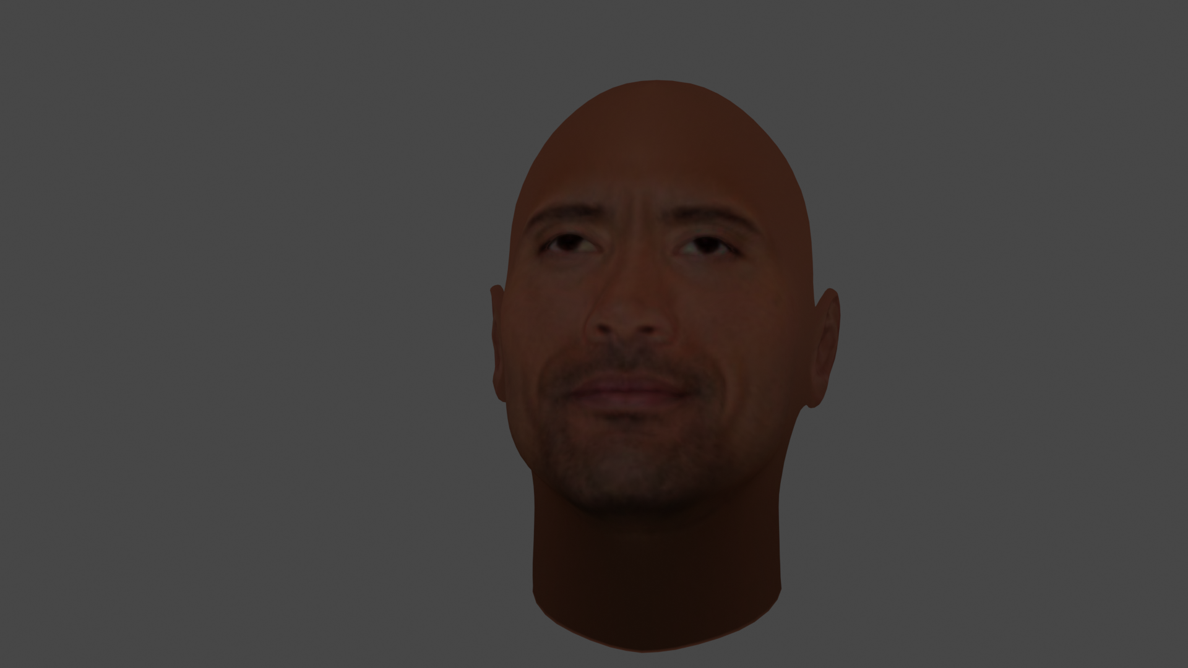
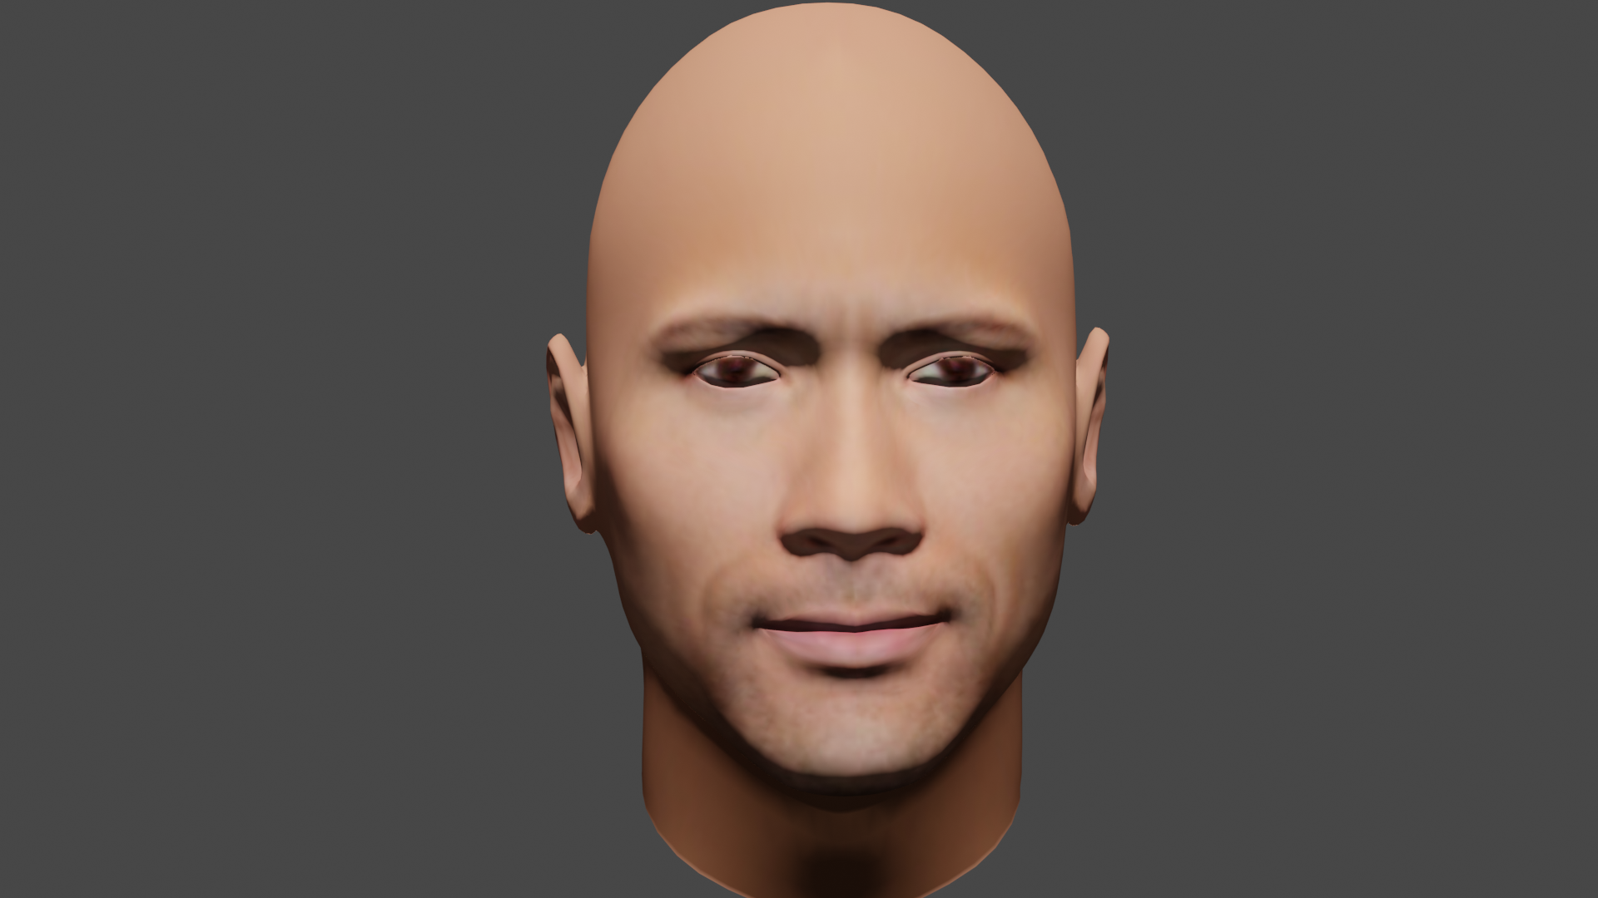
With AmbientLighting
With Ambient Lighting

Slide 18
Thank You
Mentors:
D.V.L.N Somayajulu
J. Krishnaiah
Team Members:
M. Deepika
P. Jagadeesh
G. Nagendra

